Slide 1


Emma Skarstein
rvest
https://rvest.tidyverse.org/

Slide 2

Pieta Kelsey
sjPlot
tab_model()
https://cran.r-project.org/web/packages/sjPlot/vignettes/tab_model_estimates.html

Slide 3


googlesheets4 and googledrive
9 April, 2025
Brooke N. Wolford, PhD
Marie Skodowska-Curie Fellow
@bnwolford.bsky.social
/bnwolford
brookewo@ntnu.no
brookewolford.com

Slide 4


install.packages("googlesheets4")
library(googlesheets4)
install.packages("googledrive")
library("googledrive")
https://www.tidyverse.org/blog/2020/05/googlesheets4-0-2-0/
https://googledrive.tidyverse.org/

Slide 5
googlesheets4 functions
read_sheet(“https://”)
write_sheet(data)
#adds rows to existing tbale of data
sheet_append()
gs4_formula()

Slide 6
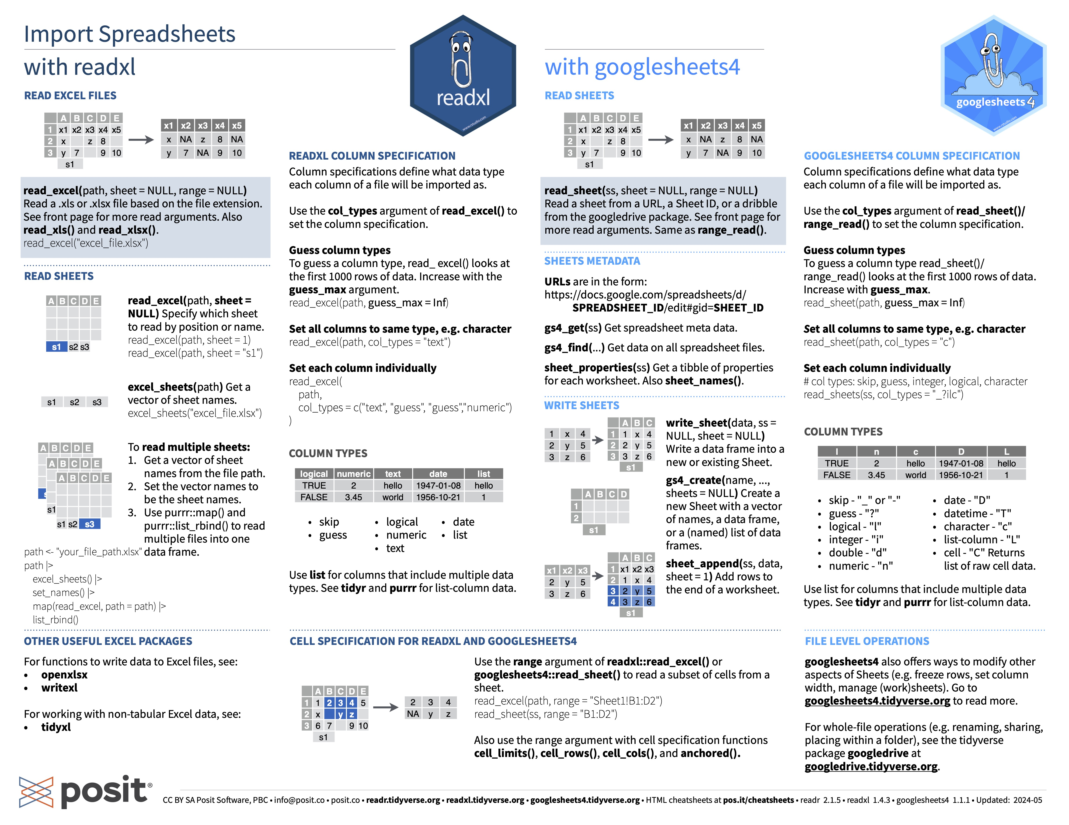
https://github.com/rstudio/cheatsheets/blob/main/data-import.pdf

Slide 7
Example use case: googledrive
#download files from google drive into local folder
file<-drive_find("INTERVENE flagship/Manuscript/Figures")
drive_download(file$name,recursive=TRUE)
#will have to authorize your google account in a web browser
folder_url<-"https://myURL”
folder<-drive_get(as_id(folder_url))
my_folder<-drive_ls(as_id(”IDXYZ"),type="csv")
walk(c(my_folder$id)) ~ drive_download(as_id(.x),overwrite=TRUE))

Slide 8

Presentation R package: ggplot2 and Rmarkdown
Elisa Moreno
PhD Candidate

Slide 9
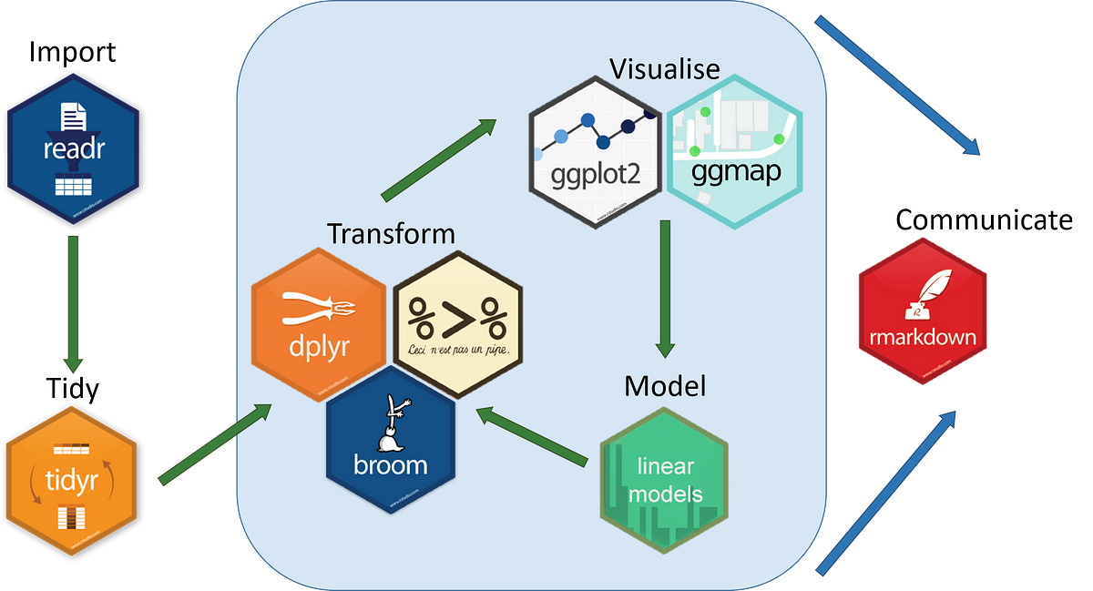

Slide 10
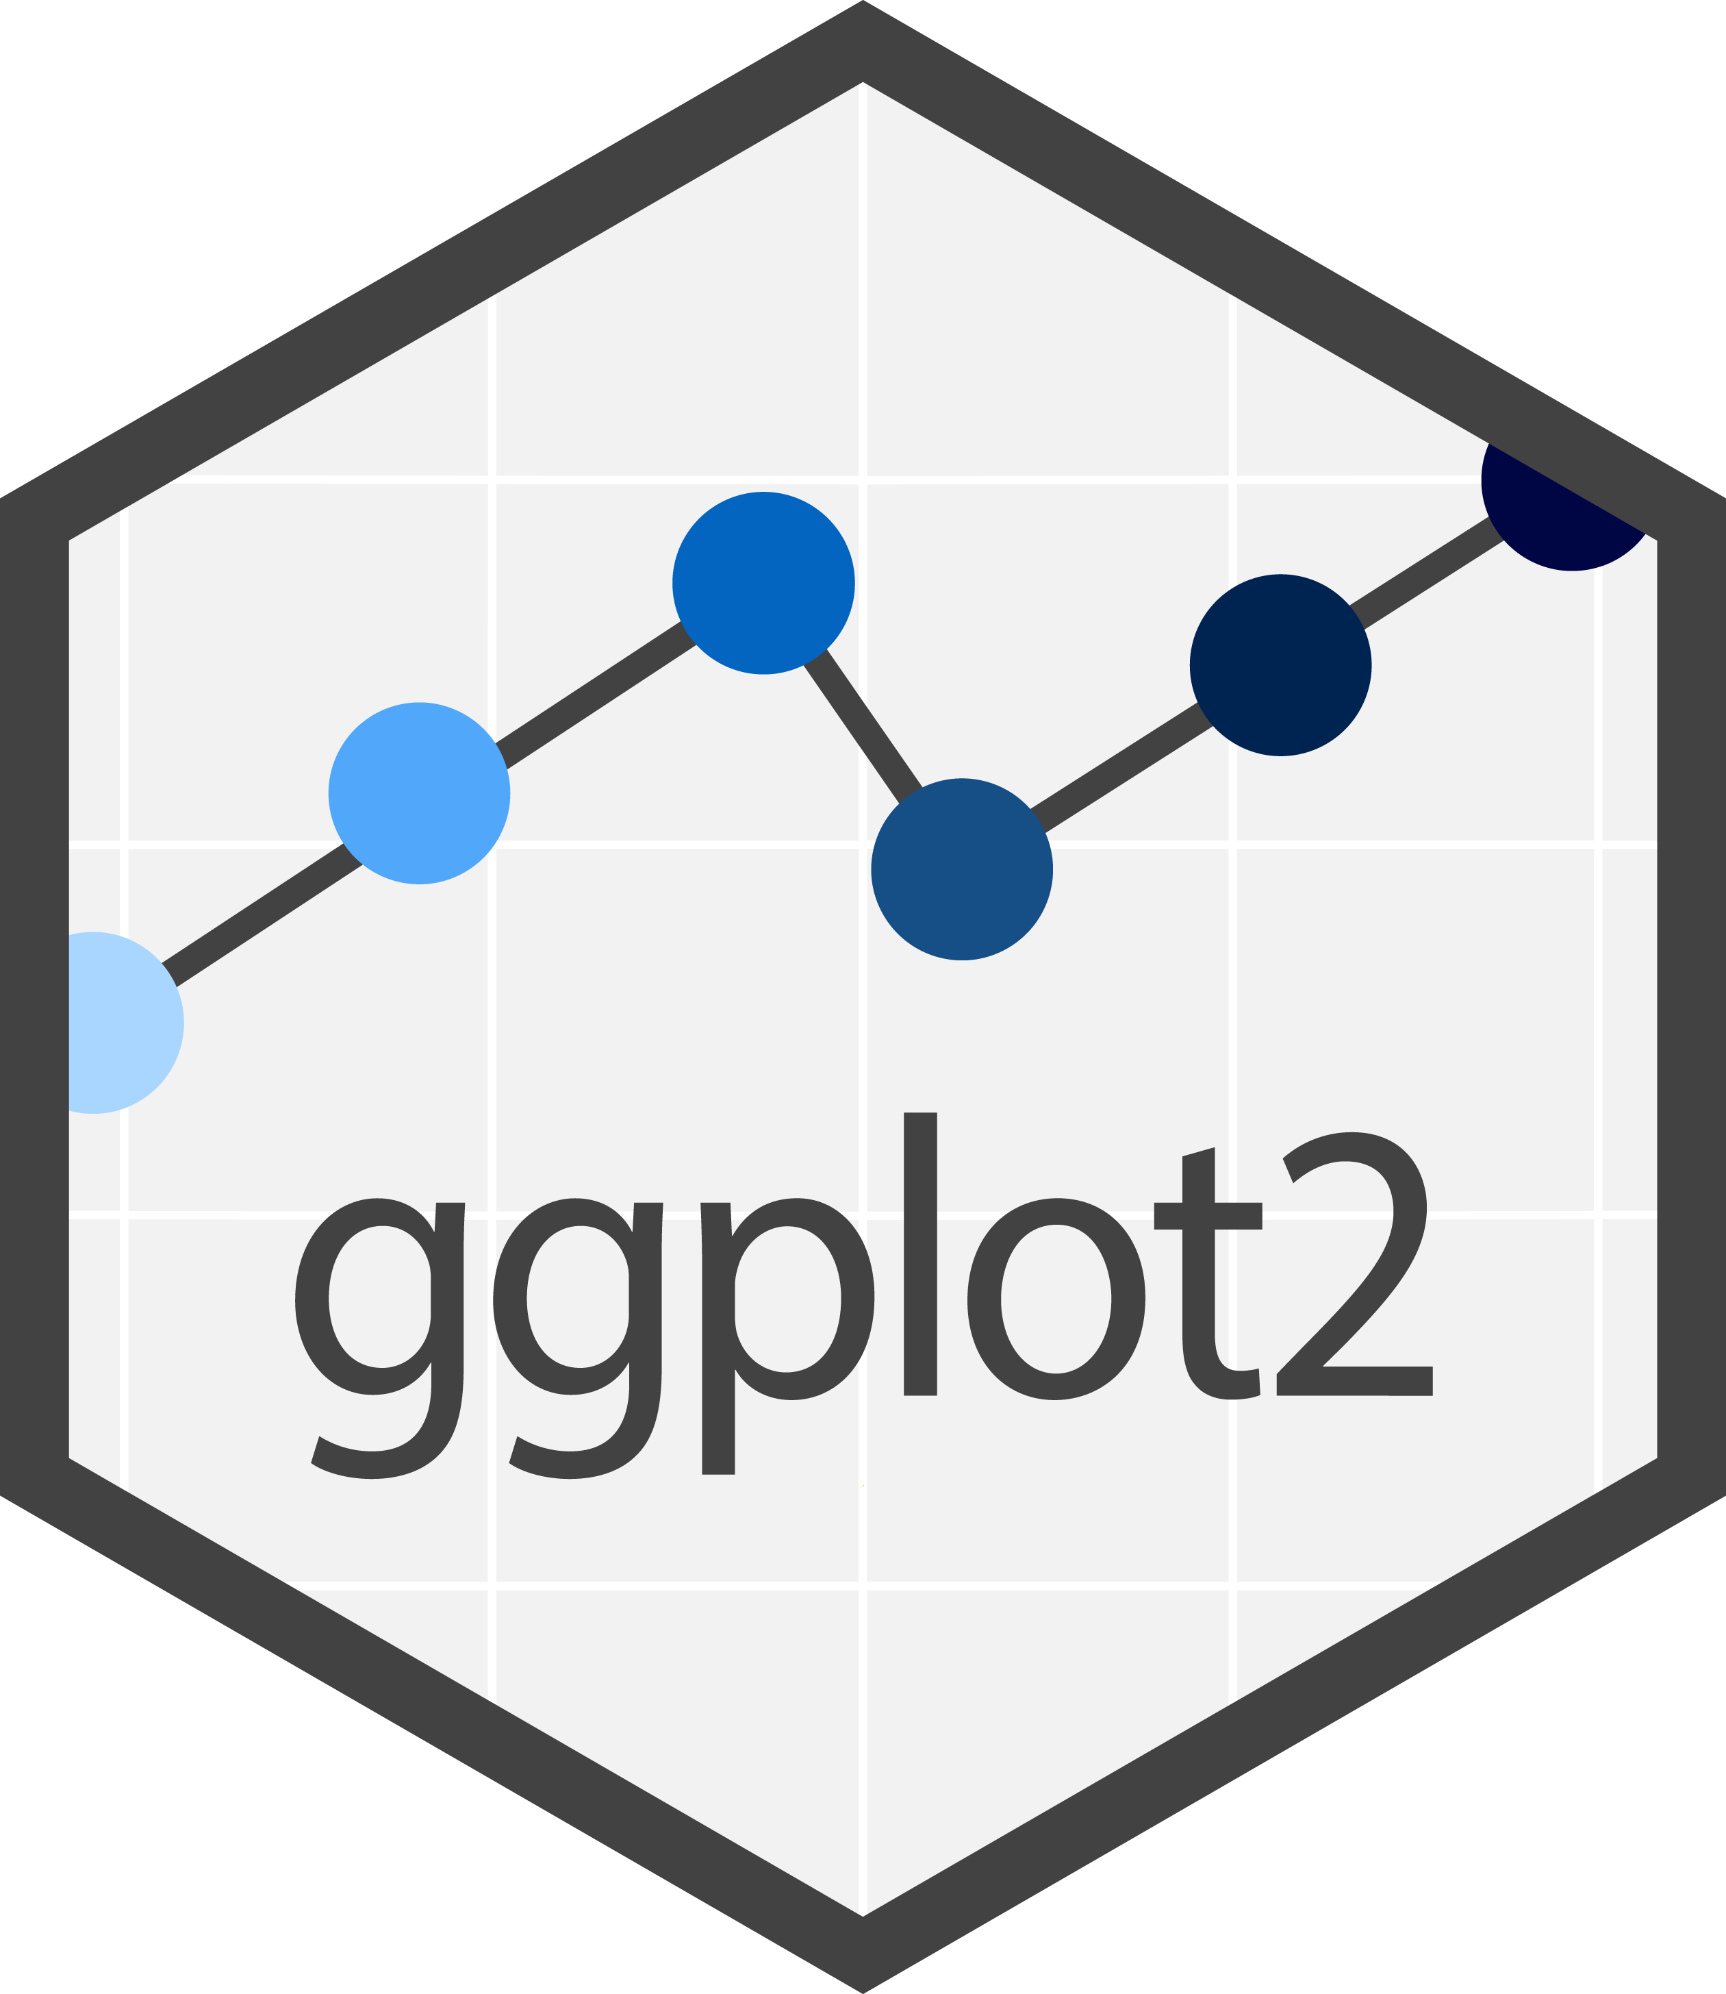
What can ggplot2 can help you to accomplish?
ggplot2 can convert complex scientific results… …into easily understandable and visually appealing graphics

Slide 11
Functions in ggplot2
Which type of graphic do I want? geom_name of graphic (ex: geom_hist, geom_point). Don’t know which representation to use or the name of the graphic?
The R Graph Gallery – Help and inspiration for R charts
How to modify axis names, legends, background? theme()
Add a title? ggtitle()
Annotate elements in the graphic? geom_label, geom_text

Slide 12
Examples of use and code:
Data visualization with R and ggplot2 | the R Graph Gallery
How to install it ?
install.packages ("ggplot2")
library(ggplot2)

Slide 14

What can Rmarkdown can help you to accomplish?
Rmarkdown can help you to
Communicate your results in one final and clear document (sentences + tables and figures) under HTML or PDF format
Share your code to ensure reproducibility and verification by others
Follow updates by colleagues and your merge contributions. Useful ++ when work in collaboration

Slide 15
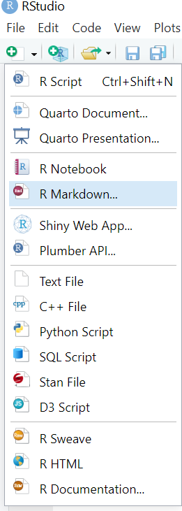
Example in direct with my own code
How to familiarize with it?
Introduction

